Slide 1
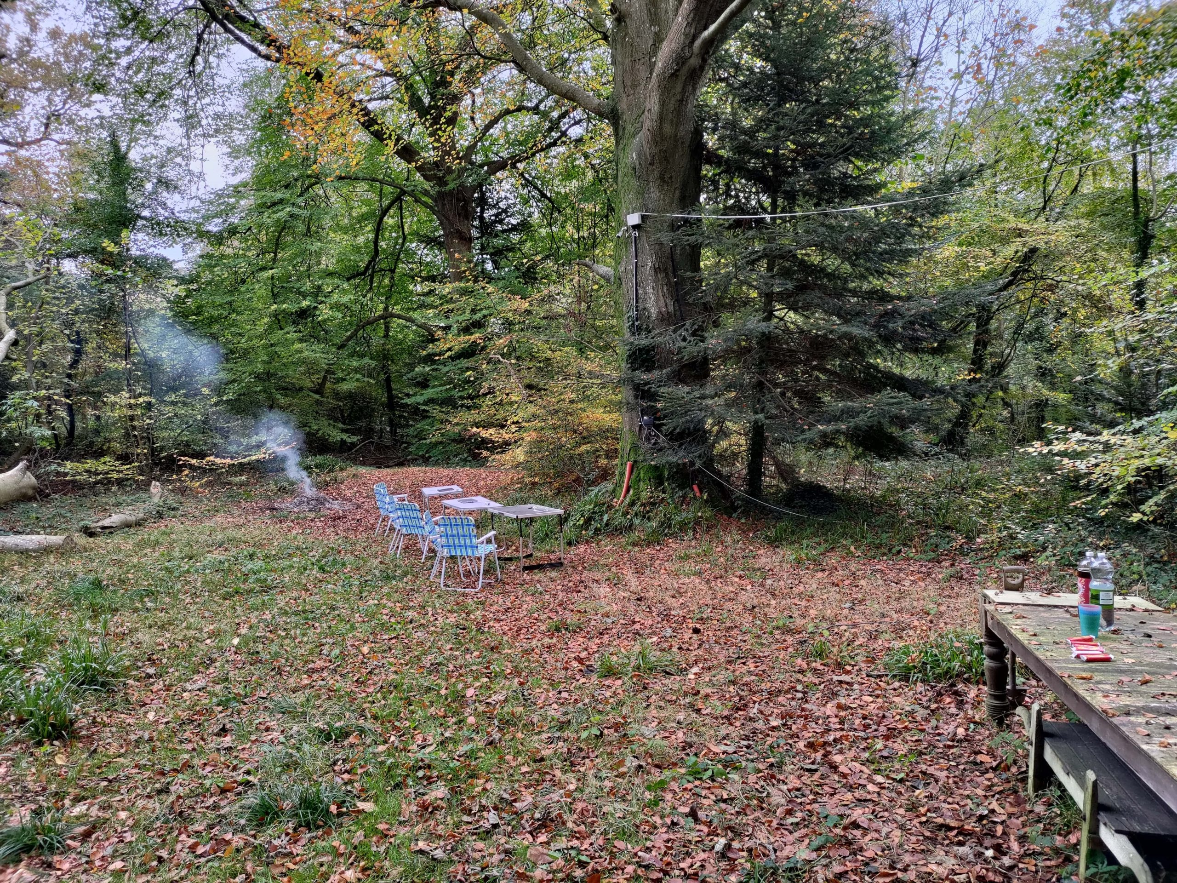
In April 2025 we will install a beehive
in the woods of Mourne Park
Bee Mission

Slide 2
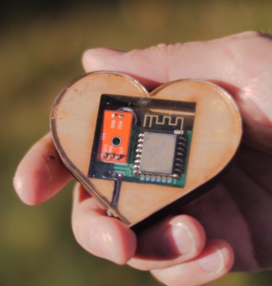
Inside that beehive will be sensors
and an endoscopic camera
Bee Mission

Slide 3
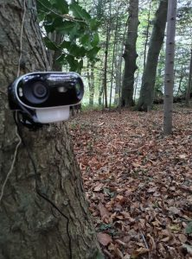
This data, along with external camera
footage of the hive, will be sent to us
for remote viewing and analysis
Bee Mission

Slide 4
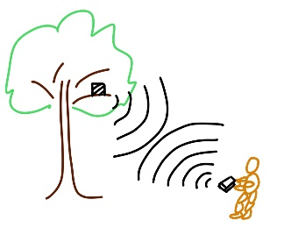
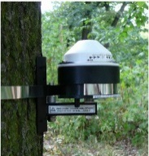
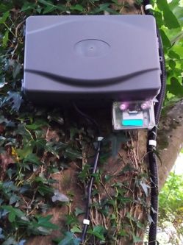
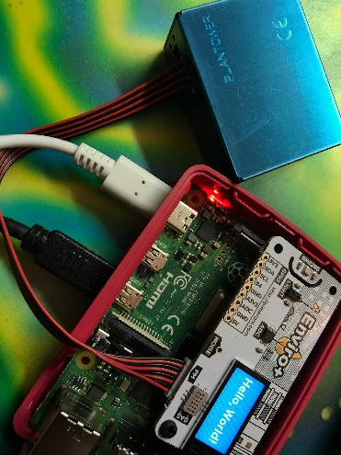
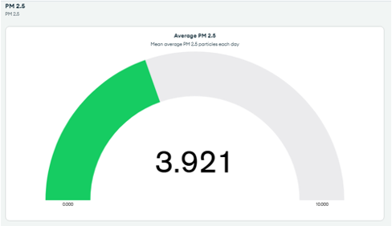
Our Mission
Wednesdays 1:30 to 3pm

Slide 5
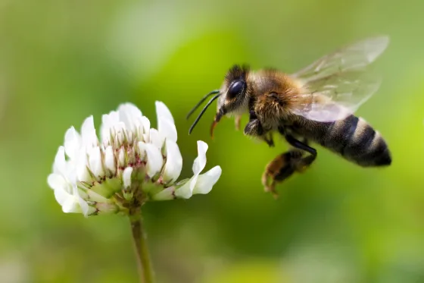
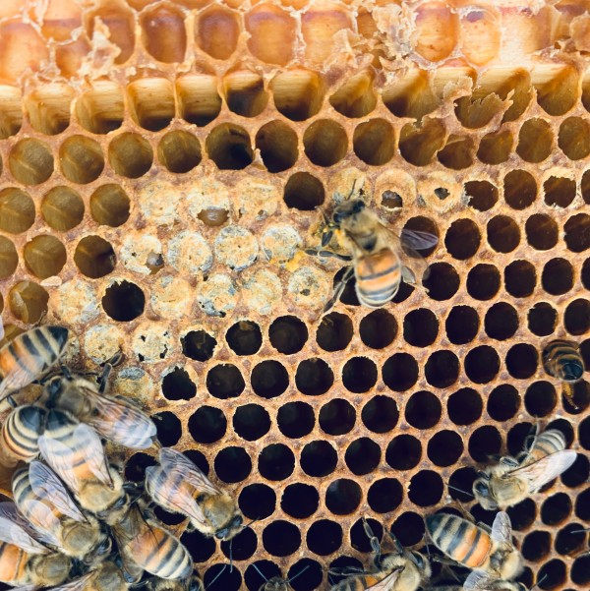
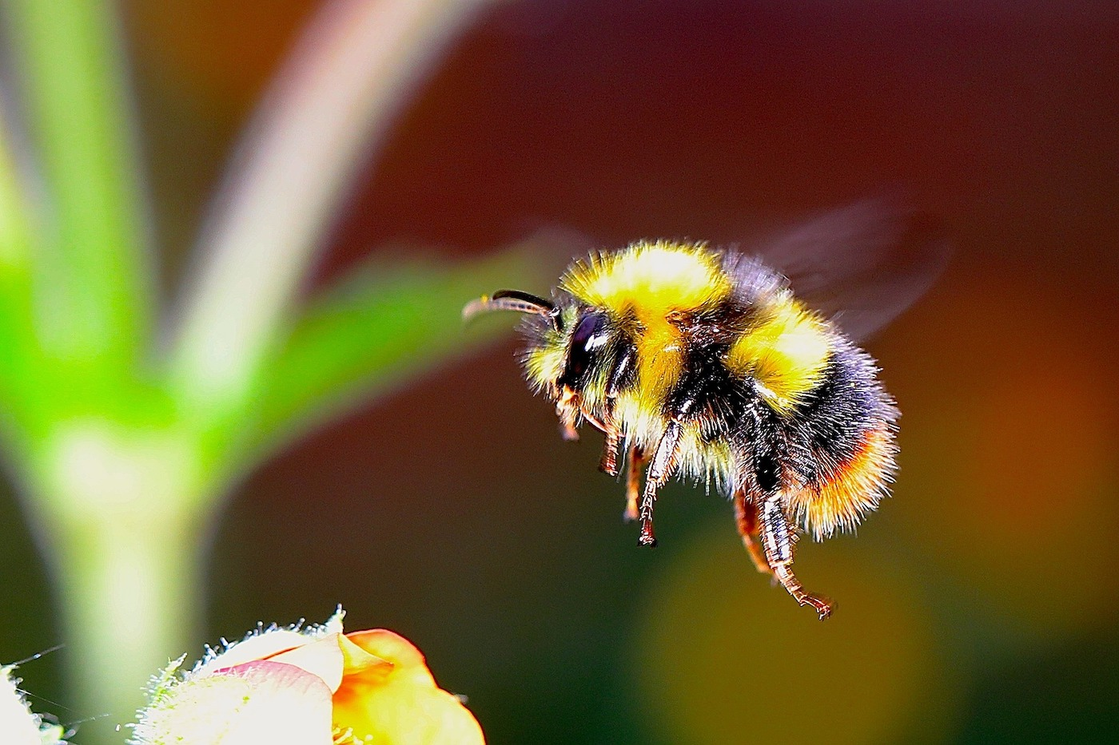
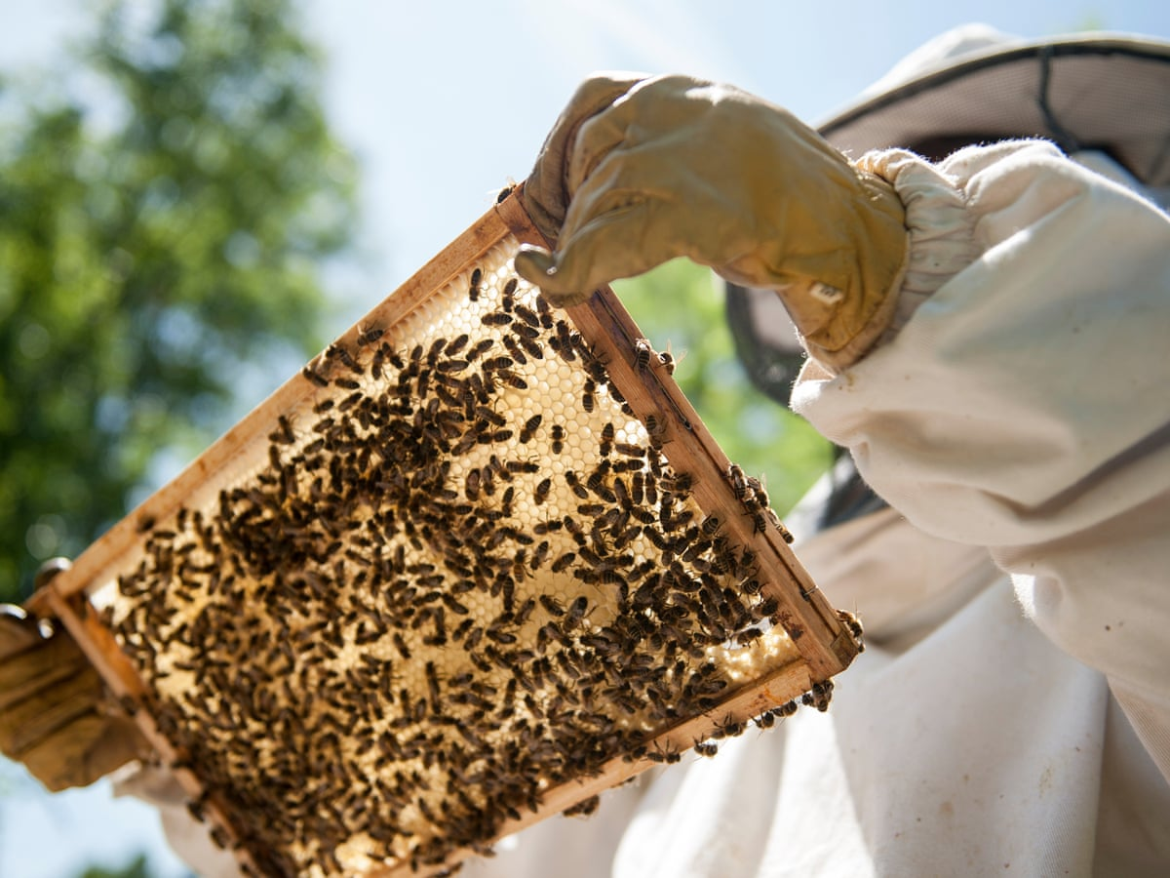
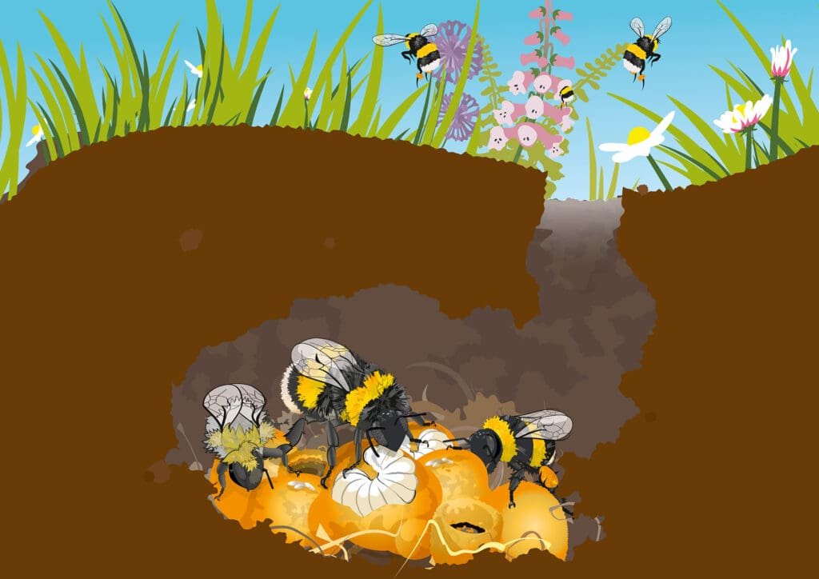
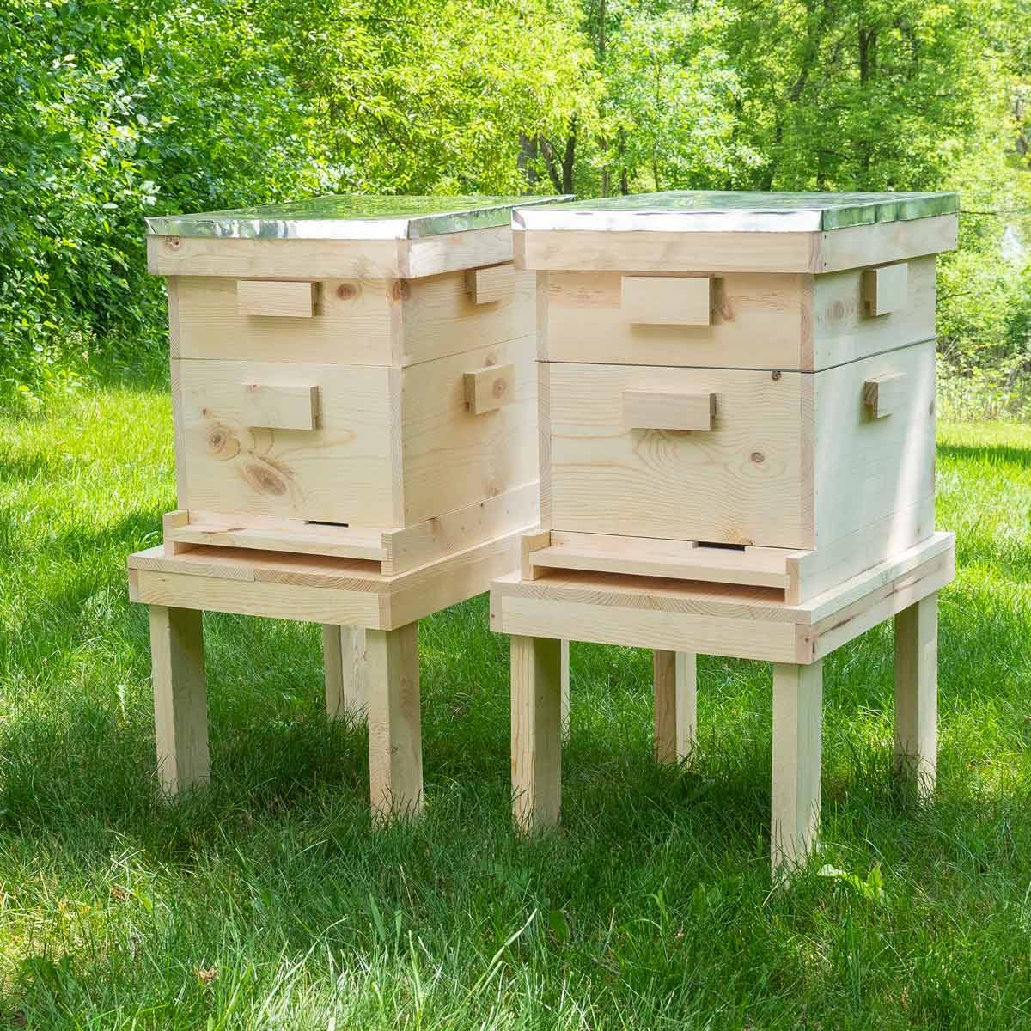
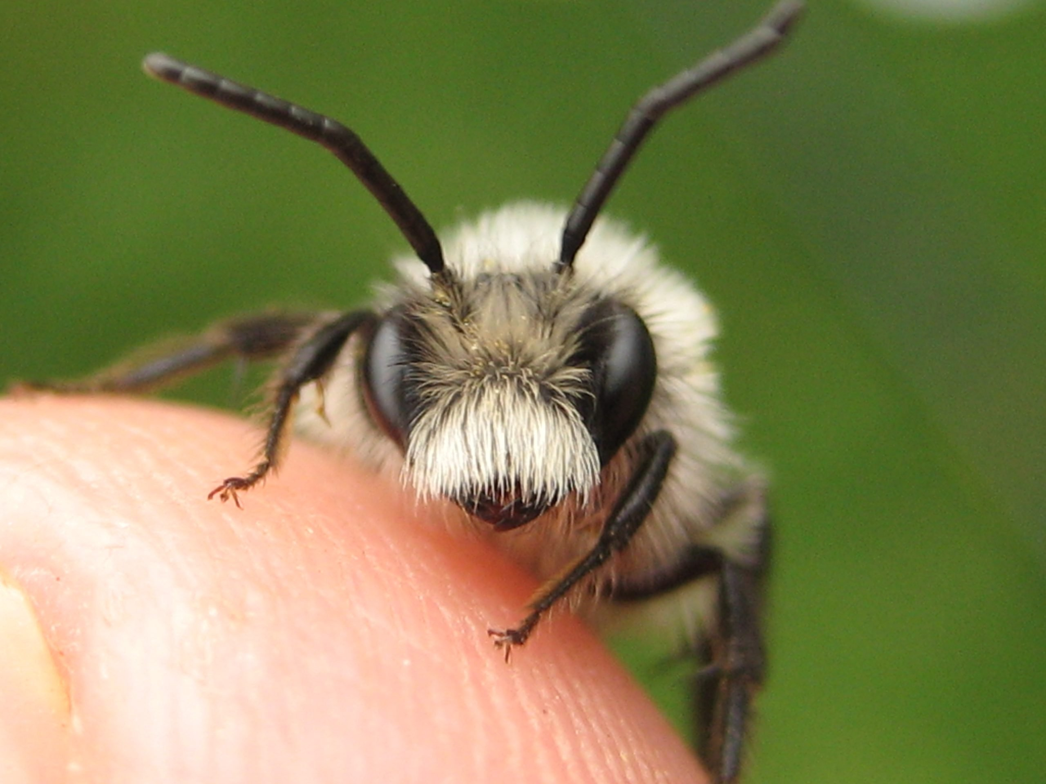
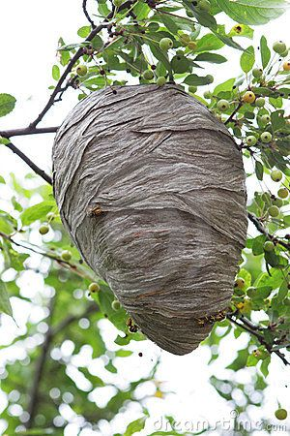
Bees are amazing

Slide 6
Wild Bees : Bumblebees and Solitary bees
Bumblebee colony: 50 – 400 individuals
Total bumblebees: 200 million
Solitary Bees: 100 million

Slide 7
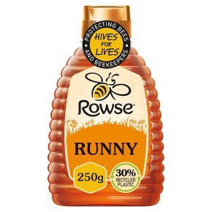
Honeybee Colonies: 300 000 managed hives
Each colony: 50 000 bees
Honeybee population: 18 000 000 000
(18 billion) bees

Slide 8
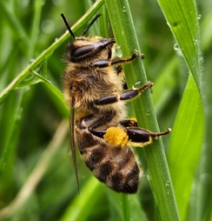
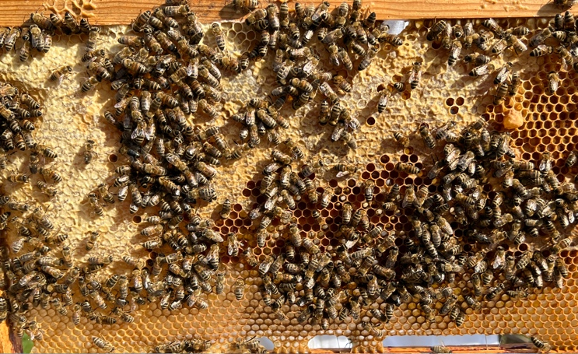
Understanding Bees: Species and Their Roles
The Diversity and Contribution of Bees
Diversity of bee species:
With around 20,000 species worldwide, bees exhibit remarkable diversity in size, behaviour, and nesting habits. This allows them to thrive in diverse ecosystems and fulfil specific ecological functions vital for plant reproduction.
Pollination and food production:
Bees are instrumental in pollinating over 75% of global food crops. This essential role sustains human diets and ensures the survival of many plants
Notes:
Understanding the diversity of bee species and their integral roles in ecosystems reveals the intricate relationships within nature
The wide array of bee species contributes not only to agricultural success but also to the overall health of ecosystems through their pollination activities
As we navigate through their contributions, we recognize the urgent need to protect these vital pollinators

Slide 9
Bees and Climate Change
Exploring the Interconnectedness of Nature
Role of bees in ecosystems
Bees serve as crucial pollinators, impacting the reproductive success of flowering plants and maintaining biodiversity.
Their activity not only supports the stability of ecosystems but enhances food security through the pollination of crops such as fruits and vegetables.
Impact of climate change on biodiversity
Climate change poses a significant threat to global biodiversity, disrupting natural habitats and altering the timing of biological events.
This shift will ultimately lead to declining populations of species, including bees, whose life cycles are tightly interwoven with seasonal changes.
Overview of technology's role in conservation
Emerging technologies offer innovative solutions to enhance conservation efforts.
For example, data analytics and remote sensing technologies enable real-time monitoring of bee populations and their habitats
Notes:
As we delve into the interlinked issues of bees and climate change, it is essential to appreciate the pivotal roles that bees play in maintaining ecological balance through their pollination
However, climate change has emerged as a formidable adversary to biodiversity, prompting a need for innovative technological interventions in conservation efforts

Slide 10
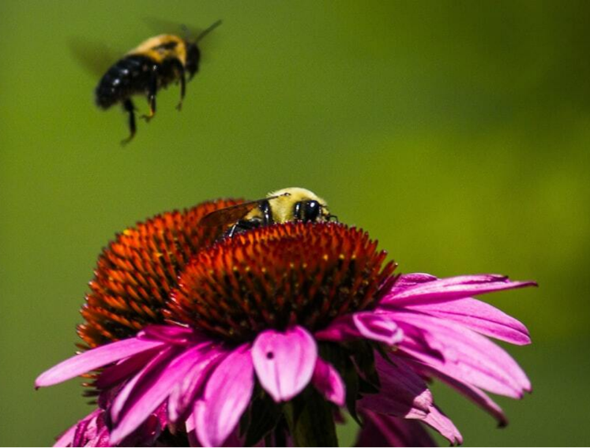
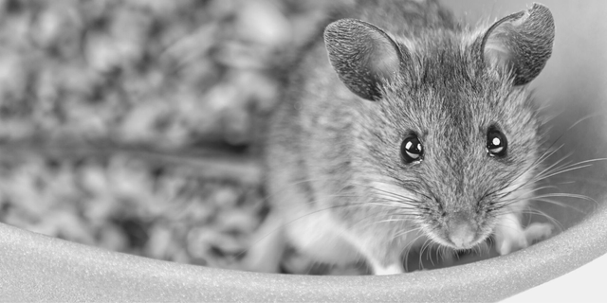
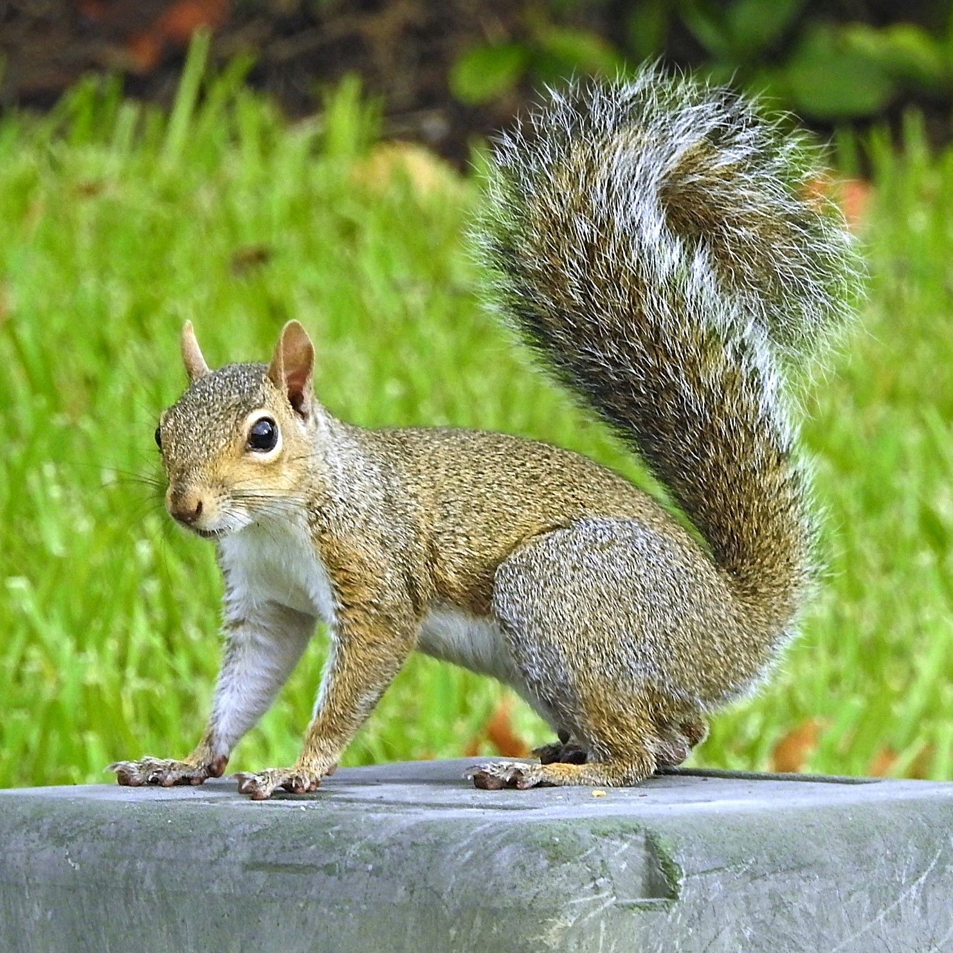
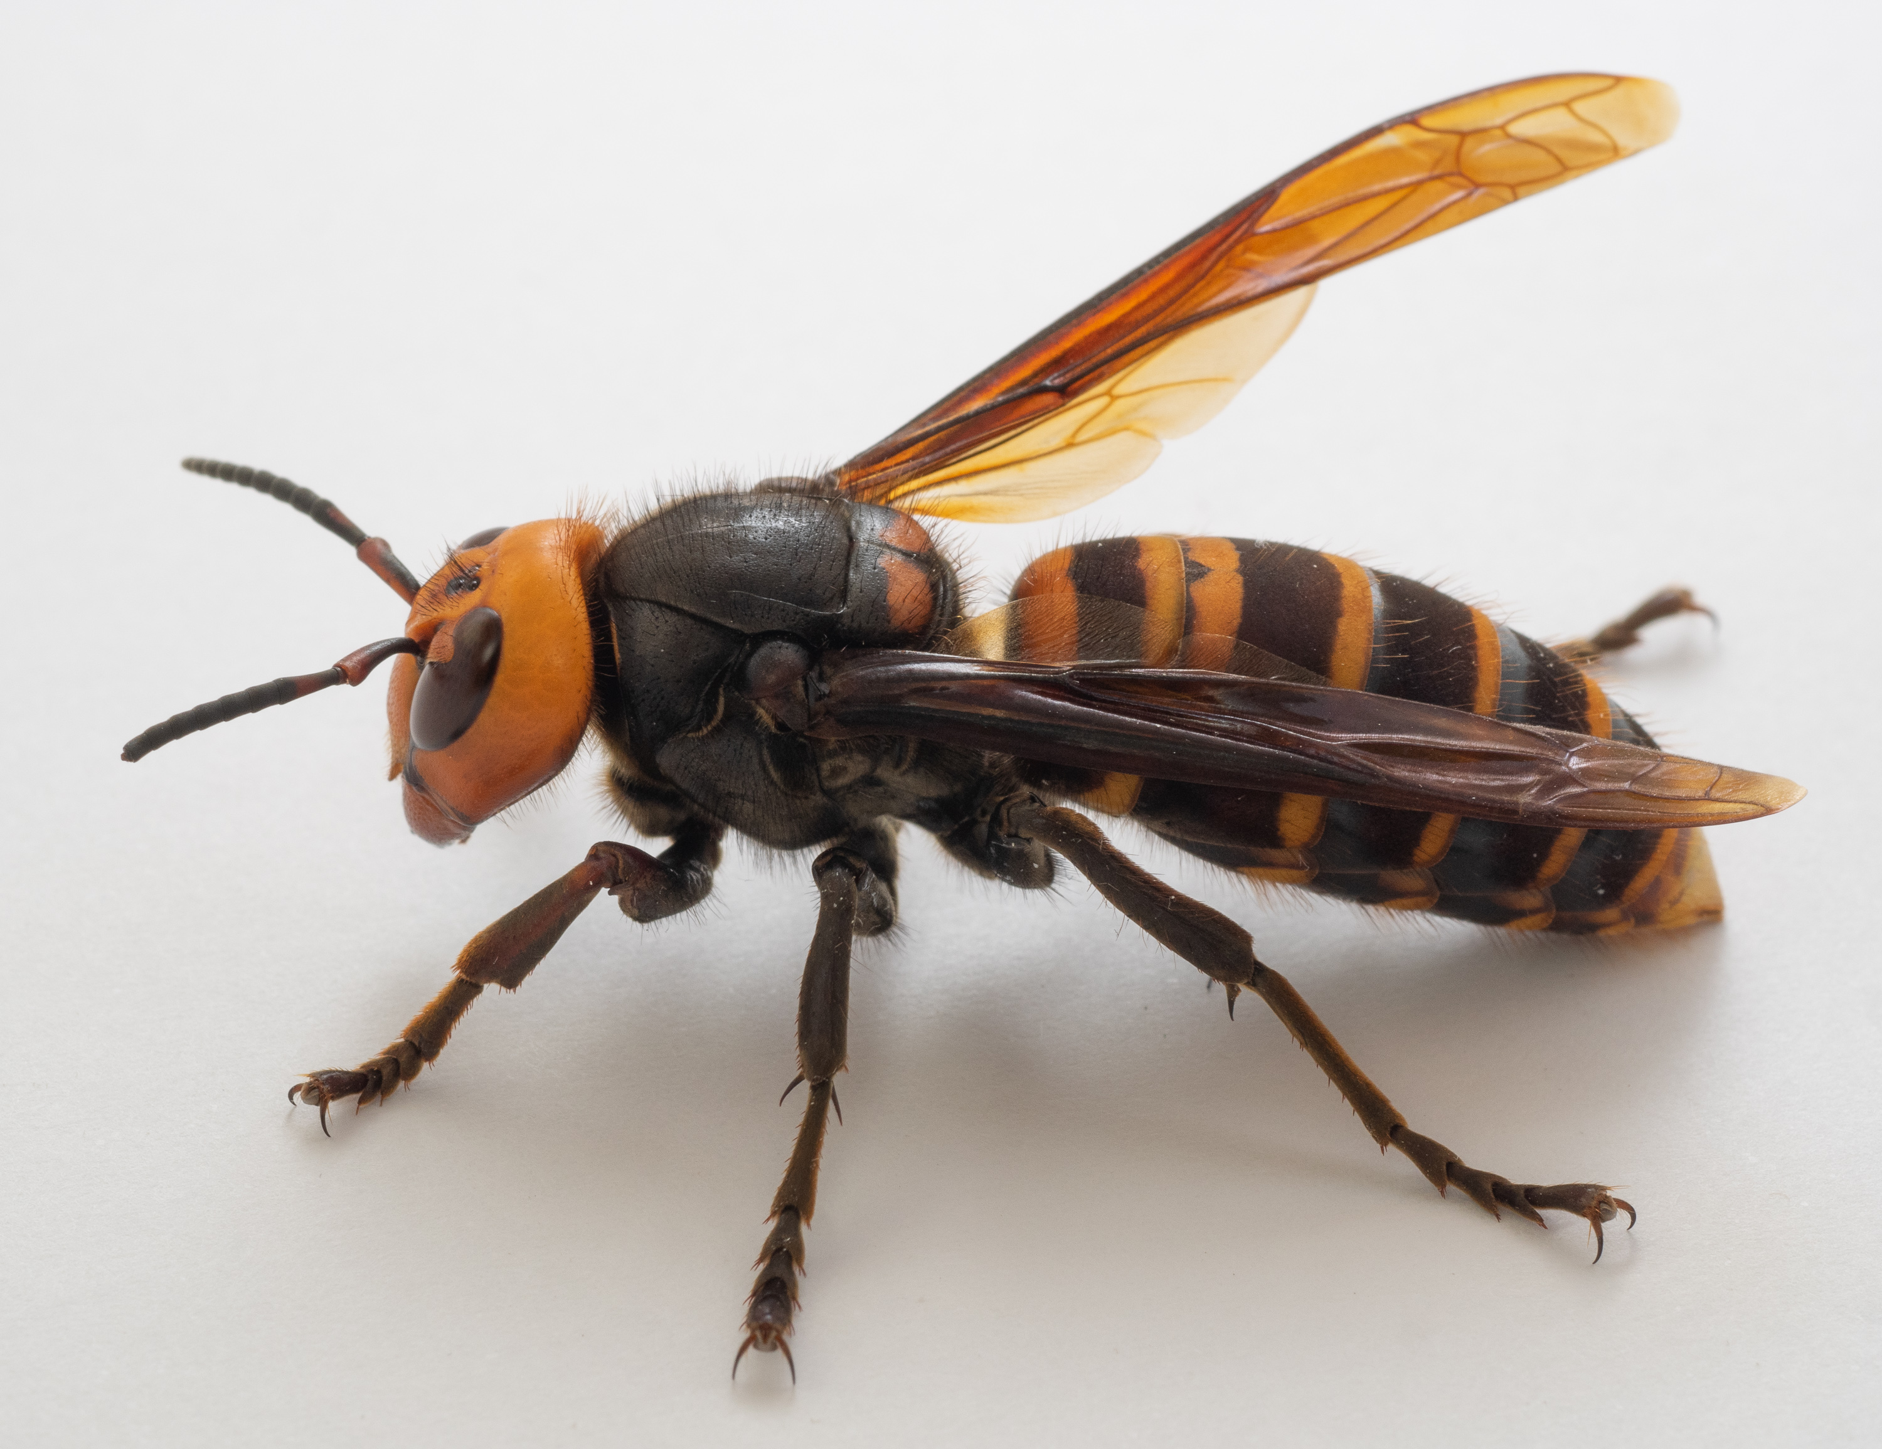
Other threats that Bees must face
Adverse Impacts of a Changing Climate
Temperature changes and habitat loss: Climate change leads to shifts in temperature and weather patterns, reducing available habitats.
Altered flowering times: As climate change affects the timing of flowering events, there is a consequential mismatch between bee emergence and the availability of resources.
Impact on bee behavior and survival: Rodents, Squirrels and the Asian Hornet threaten Bee survival.
Notes:
Climate change presents formidable challenges to bee populations and their habitats
Rising temperatures and fluctuating conditions lead to habitat loss and mismatched ecological timings, which can drasticallyincludeact bee behavior and survival rates
By examining these effects, we begin to grasp the urgency of addressing climate change not only for bees but for the ecosystems that depend on them
* Phenology: the study of how seasonal and climate variations impact biological life cycles. Phenological events include: flowering and leaf fall in plants, hibernation and migration in animals, and frog calling.

Slide 11
Adverse Impacts of a Changing Climate
What could we design and build to protect bees from the red squirrels?
This needs to happen without causing any harm to the red squirrels…
Notes:
Climate change presents formidable challenges to bee populations and their habitats
Rising temperatures and fluctuating conditions lead to habitat loss and mismatched ecological timings, which can drasticallyincludeact bee behavior and survival rates
By examining these effects, we begin to grasp the urgency of addressing climate change not only for bees but for the ecosystems that depend on them
* Phenology: the study of how seasonal and climate variations impact biological life cycles. Phenological events include: flowering and leaf fall in plants, hibernation and migration in animals, and frog calling.

Slide 12
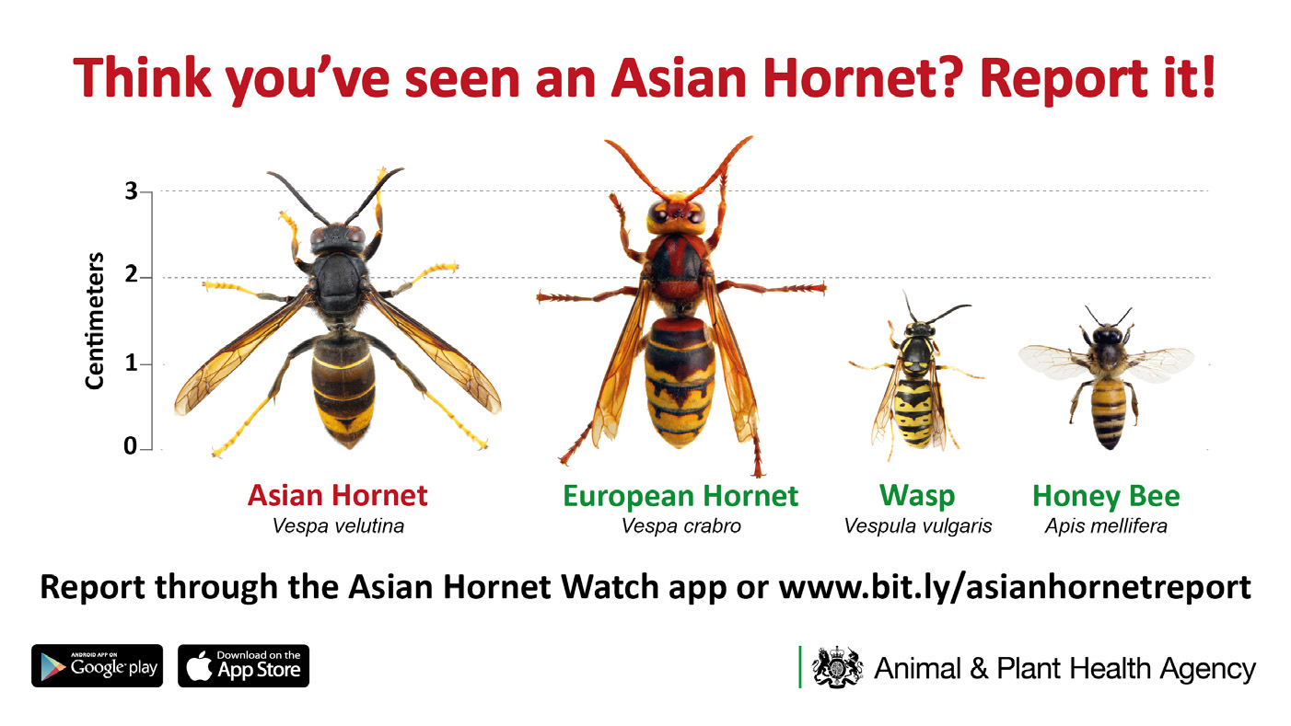
The Asian Hornet
Adverse Impacts of a Changing Climate
Temperature changes and habitat loss: Climate change leads
to shifts in temperature and weather patterns
Notes:
Climate change presents formidable challenges to bee populations and their habitats
Rising temperatures and fluctuating conditions lead to habitat loss and mismatched ecological timings, which can drasticallyincludeact bee behavior and survival rates
By examining these effects, we begin to grasp the urgency of addressing climate change not only for bees but for the ecosystems that depend on them
* Phenology: the study of how seasonal and climate variations impact biological life cycles. Phenological events include: flowering and leaf fall in plants, hibernation and migration in animals, and frog calling.

Slide 13
Technological Innovations in Bee Conservation
Harnessing Technology for Hive Protection
Use of drones for monitoring
Drones equipped with cameras and sensors allow for comprehensive monitoring of bee habitats
Data collection and analysis
Technological advancements facilitate the collection of vast datasets related to bee activity, environmental conditions, and floral availability.
Smart beekeeping technologies
Innovations such as hive monitoring apps and automated systems enable beekeepers to track hive conditions (temperature, humidity) and bee behavior in real-time, enhancing management practices and promoting bee well-being.
Notes:
The intersection of technology and bee conservation is burgeoning, with innovative tools paving the way for enhanced monitoring and management
From drone surveillance to smart beekeeping equipment, these technologies enrich our understanding of bee dynamics and empower more effective conservation practices

Slide 14
Sound Frequencies Produced by Bees: Communication and Behavior
The Acoustic Language of Bees
Bee sounds: Bees communicate through a variety of sounds, including buzzes, hums, and specific vibrations produced by wing movement. Each sound serves distinct purposes, such as alerting hive members or indicating foraging success.
Significance of sound frequencies in communication: Different sound frequencies relay critical information within the hive, influencing behaviors like foraging and hive defence. Understanding these acoustic signals is essential for interpreting their social structure and interaction patterns.
Implications for understanding bee health and behavior: Monitoring sound frequencies can serve as a non-invasive method for assessing bee health and hive dynamics. Investigating these acoustic patterns can reveal stressors affecting colonies, paving the way for informed interventions in bee management.
Notes:
Bees possess a sophisticated communication system that transcends visual cues, relying heavily on sound frequencies for hive interactions
By delving into the implications of these acoustic communications, we can uncover insights into the social dynamics of bees and develop innovative methods for monitoring their health and behavior

Slide 15
Sound Frequencies Produced by Bees: Communication and Behavior
The Acoustic Language of Bees
Notes:
The image is taken from a bee monitoring system which gathers 4 sets of data: Sound Frequency and Amplitude, temperature and humidity
The data is gathered by an inhive set of sensors, transmitted to a nearby transmitter and sent to a web portal using GPS (powered by a simple solar panel)
Different species of bee produce slightly different sound frequencies.
Focusing on honeybees:
Worker bees – 200-400Hz – Waggle dance (directions on a food source) 300-320Hz
Worker bees – 400Hz distress call
Queen – Piping 450Hz – an indication that the colony is preparing to swarm
Amplitude is a measure of loudness – high amplitude at 400Hz for example might indicate the hive is under attack

Slide 16
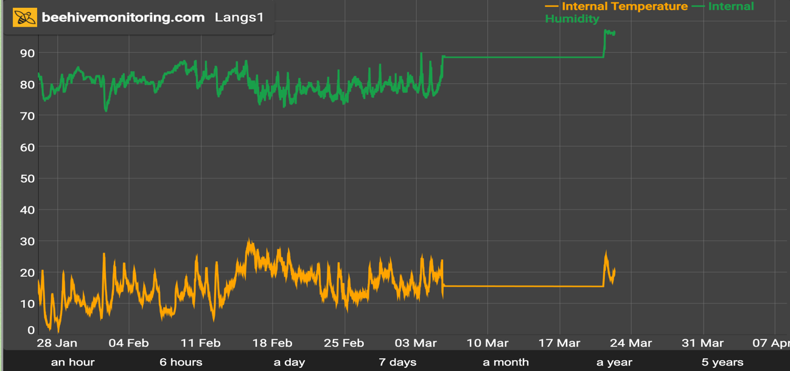
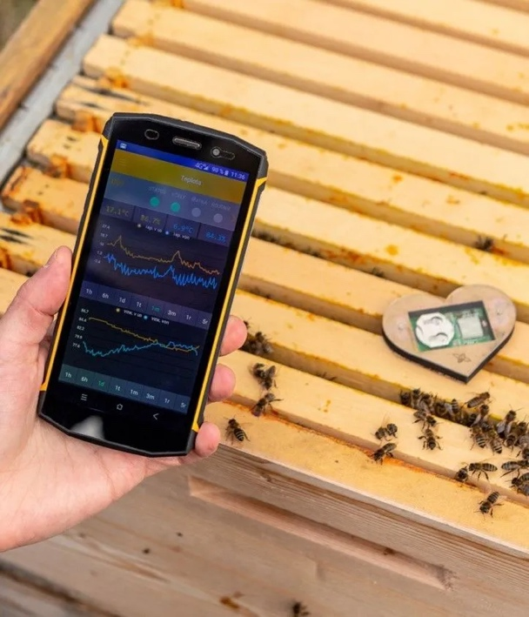
Monitoring the Bee Environment: Heat and Humidity
The Health of Bees
Notes:
The image is taken from a bee monitoring system which gathers 4 sets of data: Sound Frequency and Amplitude, temperature and humidity
The data is gathered by an inhive set of sensors, transmitted to a nearby transmitter and sent to a web portal using GPS (powered by a simple solar panel)
Ideally, a healthy beehive is in the region of 34-35 degrees C. The data gathered in this image is taken from the top of the hive, which is likely to be the coldest part of the hive internally. Adjusting for sensor placement, a picture of hive health is provided in a non-invasive manner
Humidity between 40 and 60%. With the sensor at the top of the hive excess water in the atmosphere dissipated by the bees is recorded. This gives an indication that there is a healthy level of humidity in the hive
Using a dedicated app, for this set of sensors, data can also be transmitted to nearby devices using BLE. This avoids the need for a GSM enabled device

Slide 17
Future Trends: Technology and Bee Conservation
Navigating the Next Chapter in Conservation
Potential for AI in monitoring bee health
Artificial intelligence offers innovative solutions for analyzing bee activity and health data, enabling predictive modeling and more informed management decisions that proactively address challenges facing bee populations.
Innovations in habitat restoration
Technologies focused on habitat restoration, such as soil health improvement and biodiversity enhancement strategies, present exciting opportunities for bolstering bee populations and promoting ecological resilience.
Notes:
As we look toward the future of bee conservation, emerging technologies offer promising avenues for improving strategies and outcomes
Innovations in AI, agriculture, and habitat restoration are poised to significantly impact how we protect and support bee populations

Slide 18
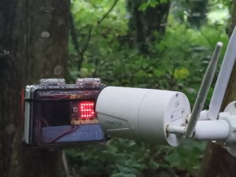
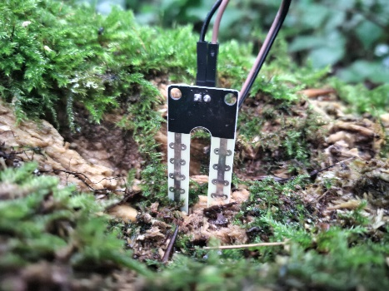
Environmental Sensing
– reproduced in the classroom
Tuesdays 3-4 KS2

Slide 19
Space To Learn video examples

Slide 20
Space To Learn video examples

Slide 21
Space To Learn video examples

Slide 22
Space To Learn video examples

Slide 23
Today:
We will start by learning
about some of the classroom equipment which
can support a study of the bees
Each week I will reveal more of the project to you

Slide 24
You and St Mary’s Catholic Primary School,
are the first schools to be shown these materials

Slide 25
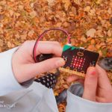
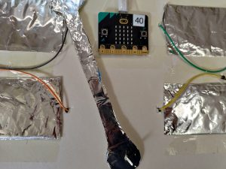
We will design and build a bee game that uses this equipment:

