Slide 1



Kodu Presentations
www.flickernet.net/bishy
Tuesday 7th May 2024
LI: Apply our knowledge of inputs and outputs to develop a computer game
which has external controls and an extra display screen
Name:

Slide 2
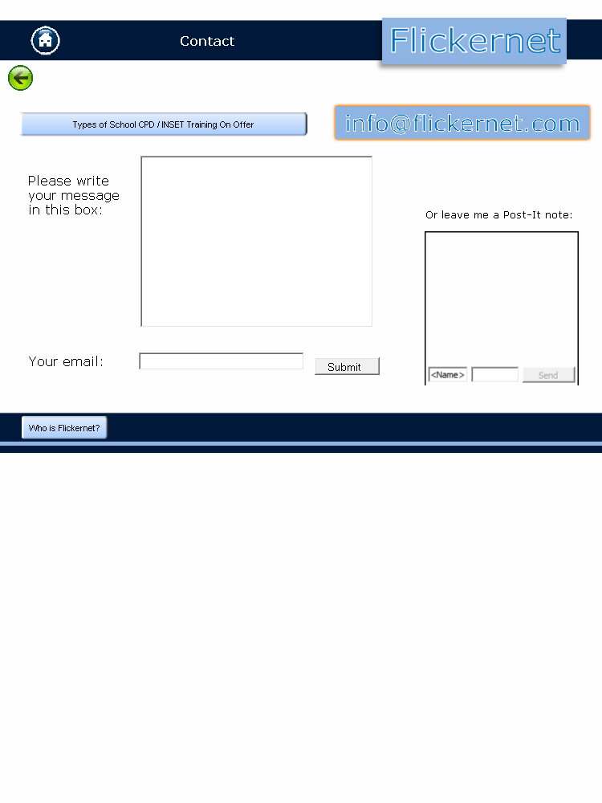

Kodu Presentation
Planning Your Game Creation
Describe your setting (for example “one small hill, a few trees and a factory with a racetrack”):

Slide 3
Kodu Presentation
Mobile Sprites (x3):

Slide 4
Kodu Presentation
Immobile Sprites (not moving, for example trees) (x2):

Slide 5
Kodu Presentation
Direct Control Keys, and which Sprite is moved (for example Rover on arrow keys)

Slide 6
Kodu Presentation
Automated movement (what sprites will move automatically and how? –
for example, Kodu will follow a path around the race track):

Slide 7
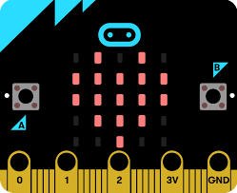
Kodu Presentation
Micro:Bit Inputs (at least A and B buttons):

Slide 8
Kodu Presentation
Micro:Bit Outputs (at least the screen):

Slide 9
Kodu Presentation
Screen Capture 1

Slide 10
Kodu Presentation
Screen Capture 2

Slide 11
Kodu Presentation
Screen Capture 3

Slide 12


Kodu Presentation
Peer Review
Name of Reviewer:

Slide 13
Kodu Presentation
Own Review

Slide 14
Kodu Presentation
Comments

